Slide 1

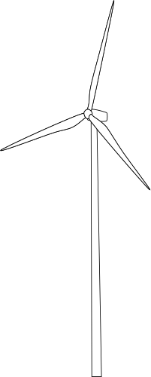
SMART MANUFACTURING: FUEL EFFICIENCY AND TURBINE HEALTH ANALYTICS ON AZURE CLOUD
TEAM:
SEDHULINGAM N
NAGARAJU S M
BHARATH M
PREMNATH S
ZAHID KHAN Z

Slide 2
TABLE OF CONTENT
03
30
Phase 1
Phase 4
11
38
Phase 2
Phase 5
18
46
Phase 3
Phase 6

Slide 3
Tasks
Draft Software Requirements Specification (SRS) for the turbine health platform.
Define functional and non-functional requirements.
Create High-Level Design (HLD) to represent modules (Ingestion, ETL, Monitoring, API).
Generate UML diagrams:
o Use Case Diagram – turbine data ingestion, anomaly detection, API access.
o Deployment Diagram – Azure VMs, ADLS, ADF, FastAPI integration.
o Component Diagram – ingestion, transformation, visualization.
PHASE 1

Slide 4
Data Ingestion
The system shall ingest turbine sensor data (from files or live streams).
The system shall validate the input structure against predefined feature definitions.
Data Transformation & Storage.
The system shall clean and transform raw data (handle missing values, outliers).
The system shall compute derived features (e.g., efficiency ratios, decay coefficients).
The system shall store data in structured layers (Raw, Silver, Gold).
Analytics & KPI Computation
The system shall calculate KPIs such as average fuel consumption and turbine efficiency.
The system shall detect anomalies based on threshold rules or statistical checks.
FAST API Services
The system shall provide a health-summary API to return turbine KPIs.
The system shall provide a sensor-metrics API to return recent telemetry.
The system shall provide a anomaly-alerts API to record and retrieve anomalies.
Visualization
The system shall provide dashboards DataBricks dashboard.
The dashboards shall refresh automatically with new Gold layer data.
FUNCTIONAL REQUIREMENTS

Slide 5
Performance
API responses shall be returned within minimum time for cached queries.
ETL pipelines shall process new data batches within least latency.
Scalability
The system shall handle max records/day with a higher growth capacity.
Reliability & Availability
The system shall ensure maximun uptime for ingestion and API services.
No data loss shall occur during ingestion and transformation.
Maintainability
Code shall be modular (separate ingestion, transformation, API, visualization modules).
Automated test coverage shall ensure easy defect identification.
Security
All API calls shall use HTTPS.
Data at rest shall be encrypted in ADLS.
Usability
Dashboards shall be intuitive for operators with minimal training.
API documentation shall be auto-generated using Swagger UI.
NON FUNCTIONAL REQUIREMENTS

Slide 6
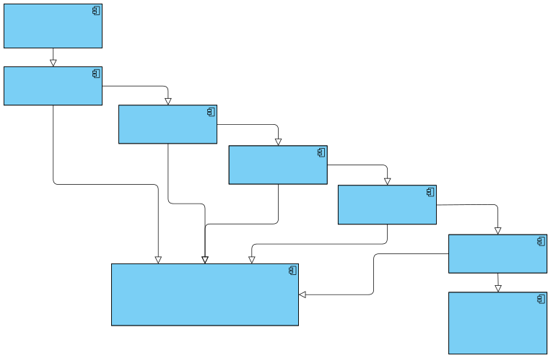
External sources
HIGH-LEVEL DESIGN (HLD)
Raw data
Data Ingestion Module
Pre processed data
ETL module
Cleaned / Structured data
Storage / Data Lake
Data pipeline
ETL Job status
Ingestion status
Databricks
databricks table
Logs / metrics
Logs / metrics
API Module
Monitoring and Data
logging
API Metrics
Data Responses
External Clients / Applications

Slide 7

UML DIAGRAMS

Slide 8
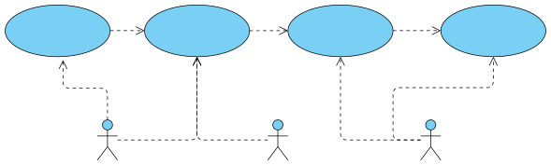
USE CASE DIAGRAM
Ingest Turbine Data
Transform and store data
Detect Anomalies
Send Alerts
Data Engineer
Data Scientist AI / ML
Turbine Operators

Slide 9
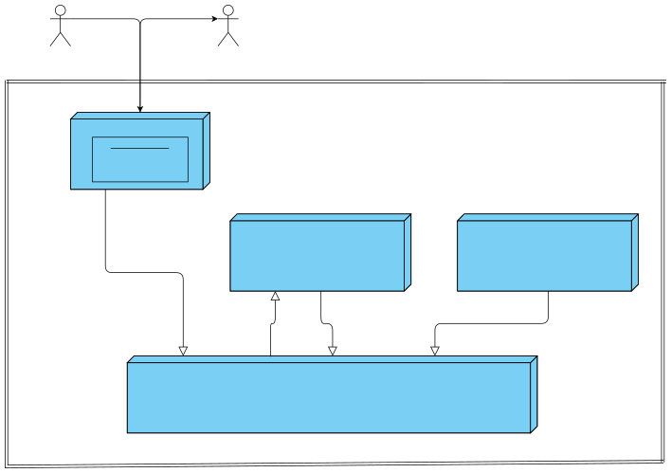
DEPLOYMENT UML DIAGRAM
Sensor Data
Turbine health metrics
Turbine Sensors
Client Dashboard
get
post
Azure Data factory
Azure VM
FastAPI Server
Azure Databricks
Data Science / ML models
Store raw data
Read / Write processed data
Read processed data for ML
Preprocess data
Azure Data Lake Storage (ADLS)

Slide 10
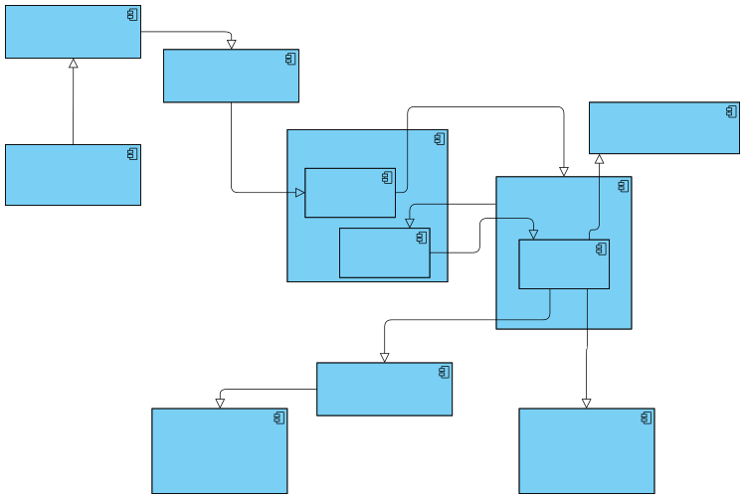
<<component>> Data Ingestion Module
Pre processed data
COMPONENT UML DIAGRAM
<<component>> ETL module
RAW data
Access key, Endpoints
<<component>> Monitoring and Data logging
<<component>> DataLake
<<component>> External sources
Requirement specific data
Data logs
<<component>> Silver Container
<<component>> Databricks
Cleaned / Structured data
<<component>> Gold Container
<<component>> Tables
Swagger
Data Responses
<<component>> API Module
<<component>> External Clients / Applications
<<component>> Power BI (Visualization)

Slide 11
Tasks
Write Python code to ingest CSV sensor logs.
Perform data cleaning (nulls, outliers, smoothing).
Compute derived features (e.g., temperature-pressure ratios, torque differentials).
Use Pandas and NumPy for initial EDA.
PHASE 2

Slide 12
PYTHON CODE

Slide 13
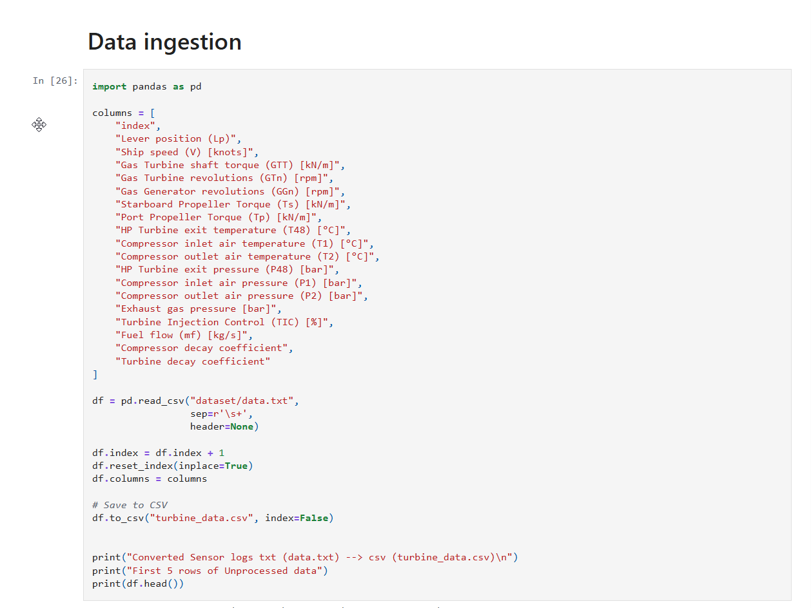
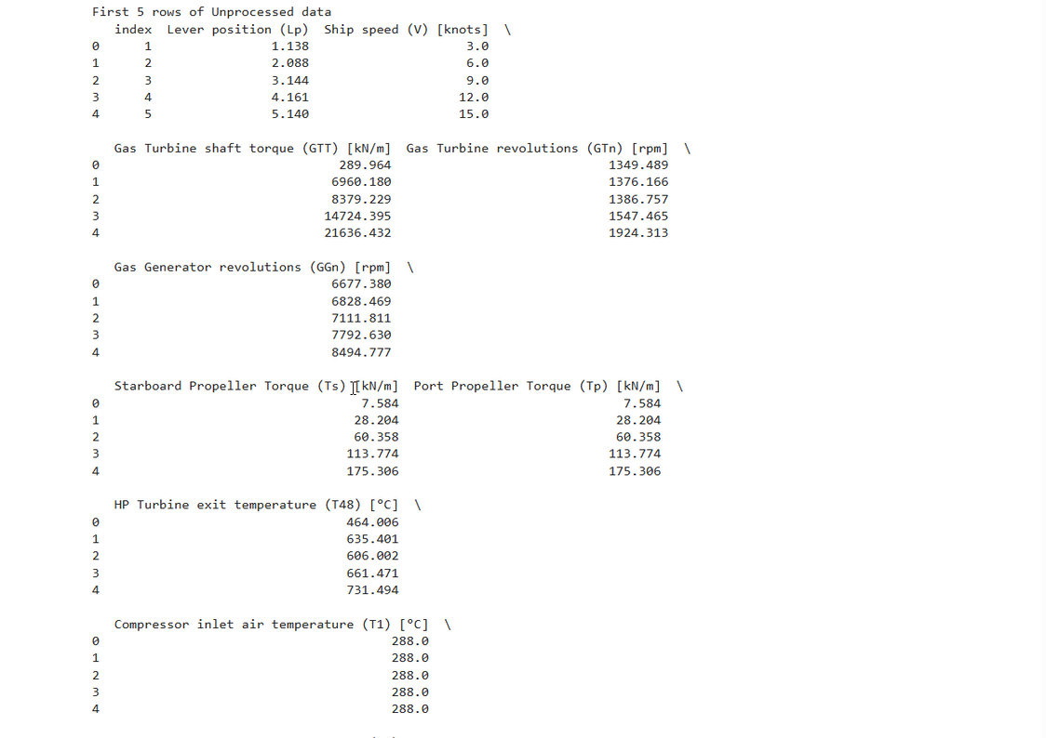

Slide 14
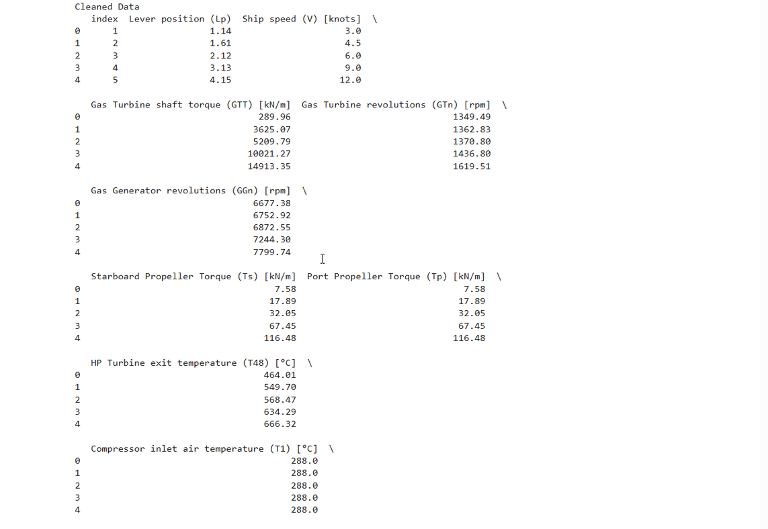
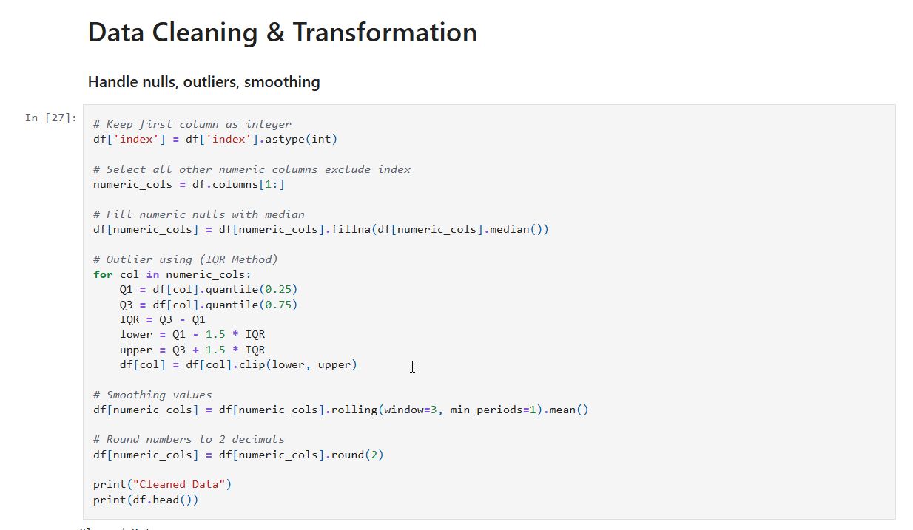

Slide 15
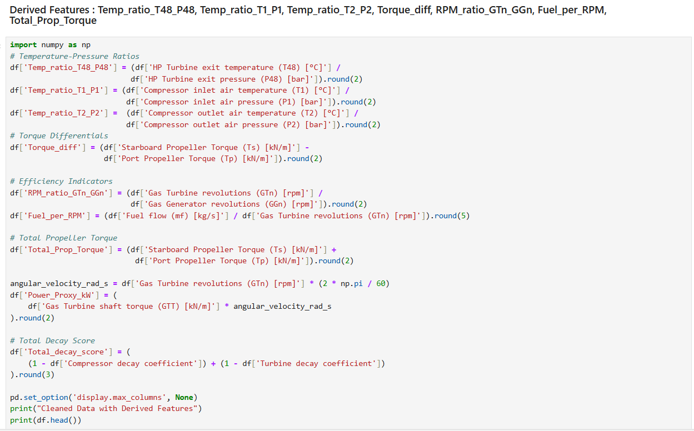

Slide 16
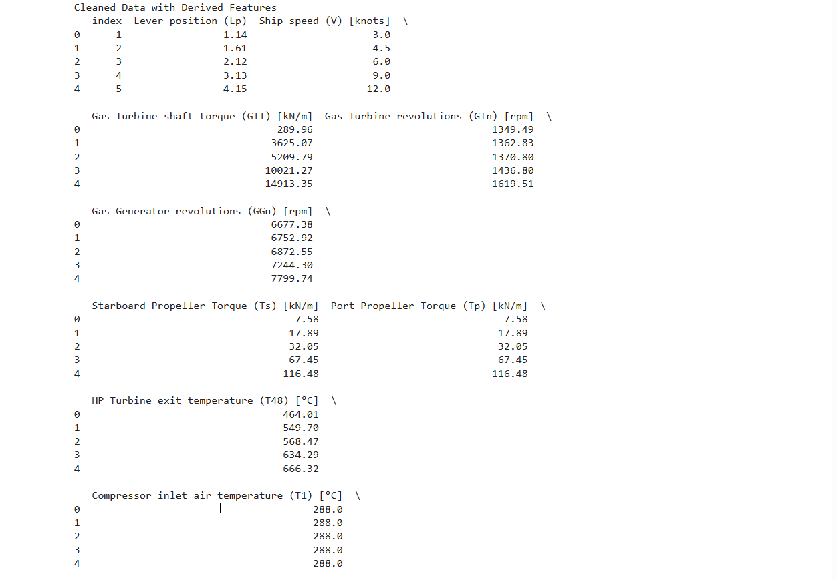
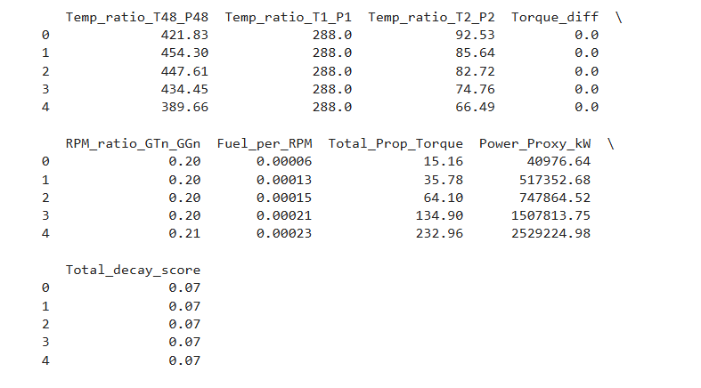
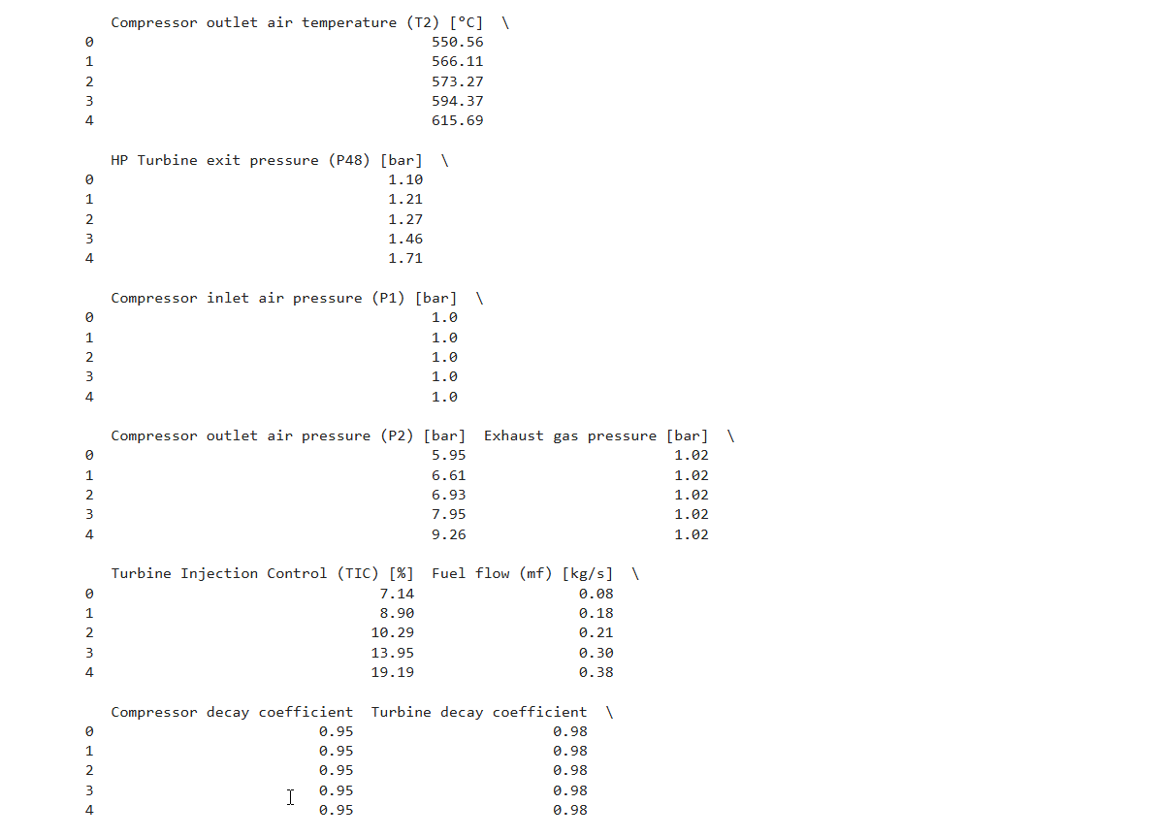

Slide 17
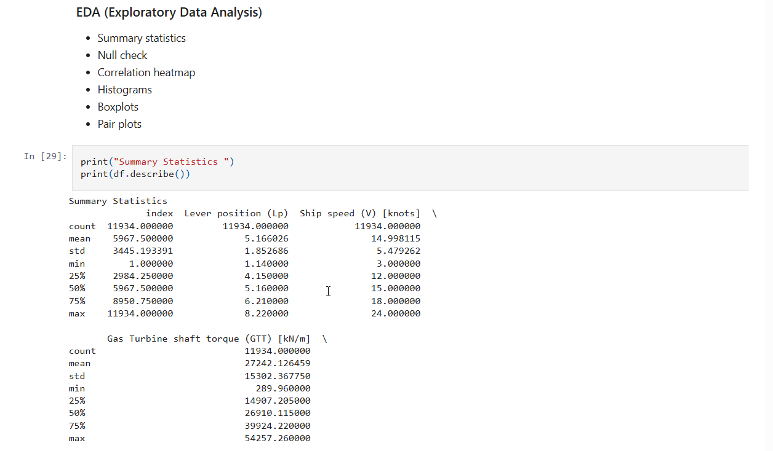
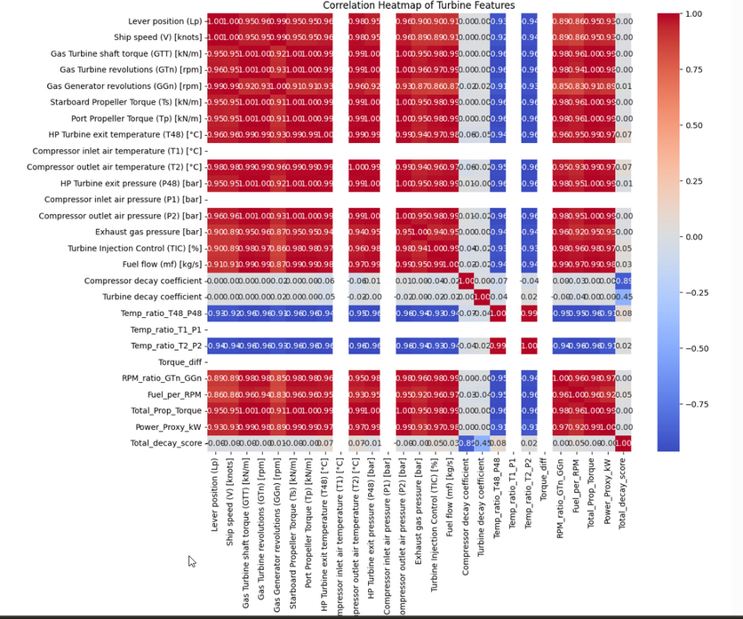
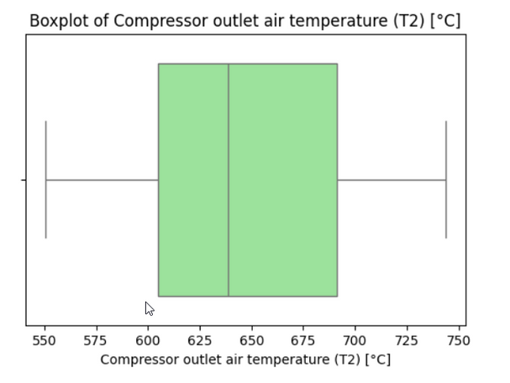

Slide 18
Tasks
Create SQL tables: sensor_readings, alerts, turbine_metadata.
Use SQL for transformations: joins, filters, aggregations.
Analyze:
o Fuel usage patterns over
time
o Turbine efficiency comparisons
Visualize results using Matplotlib / Seaborn.
PHASE 3

Slide 19
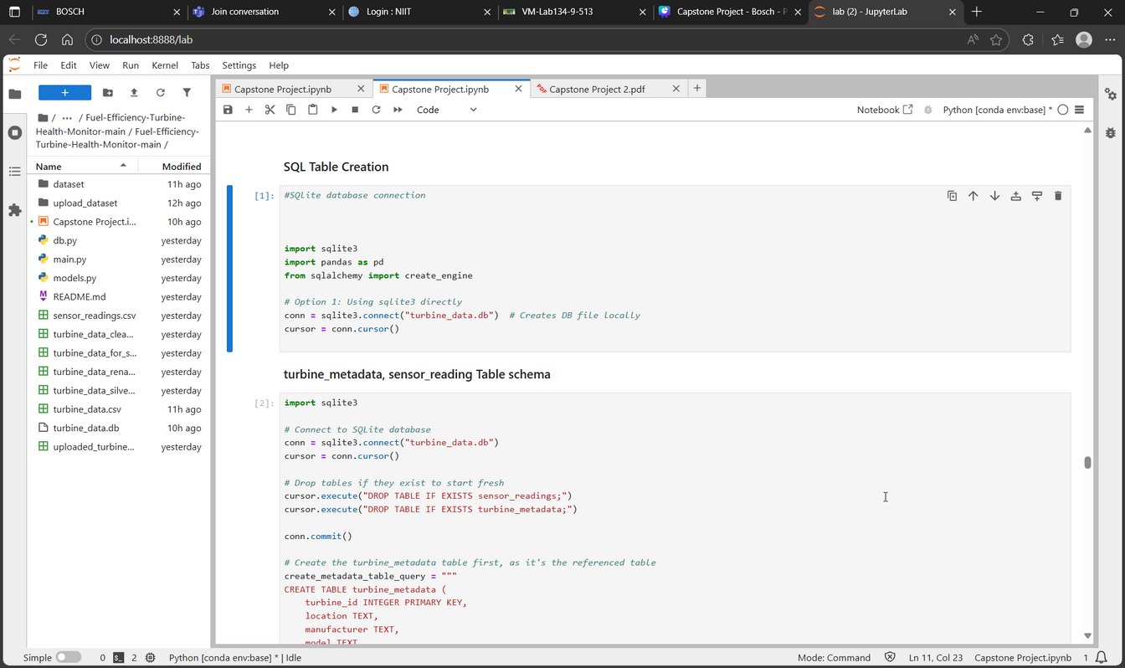
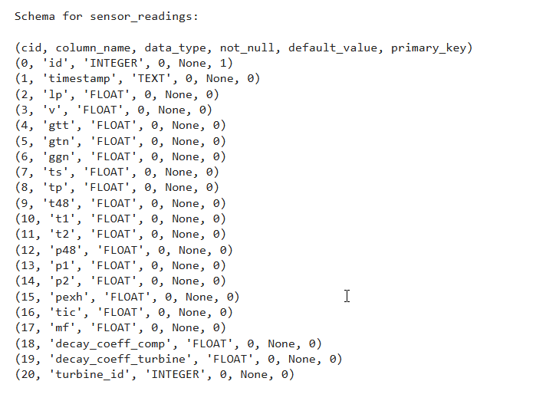
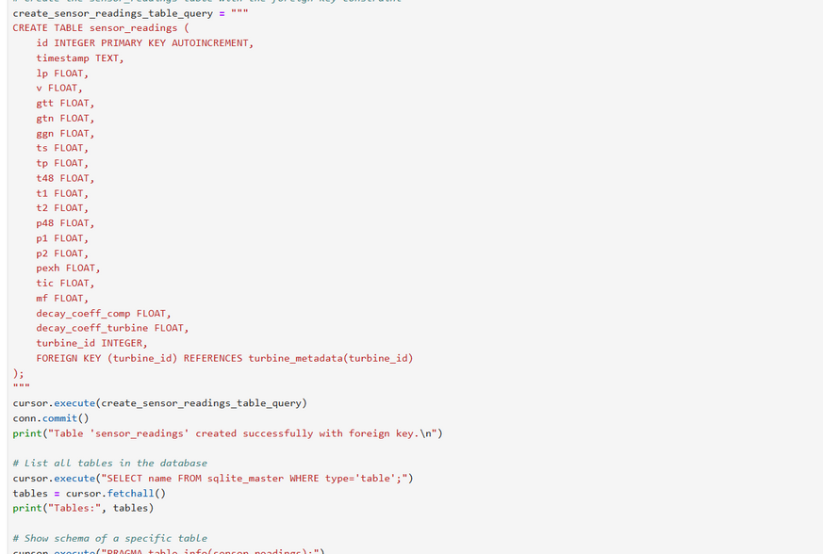
SQL TABLE CREATION
SENSOR READINGS TABLE

Slide 20
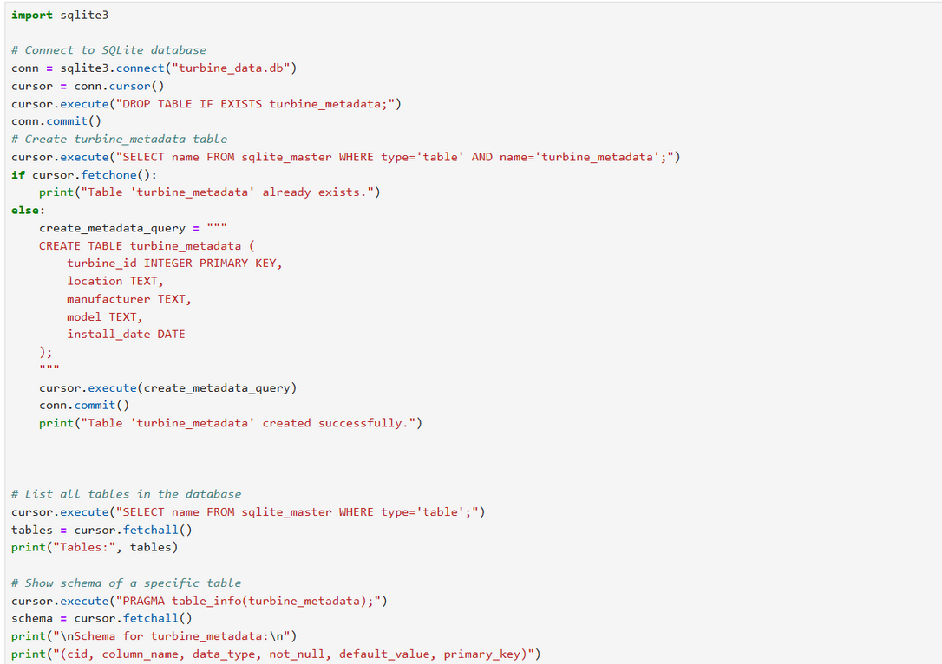
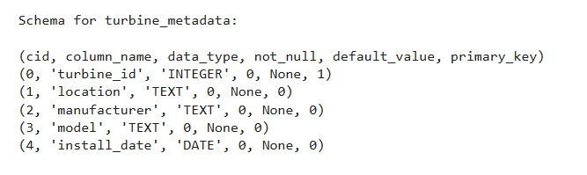
SQL TABLE CREATION
TURBINE METADATA TABLE

Slide 21
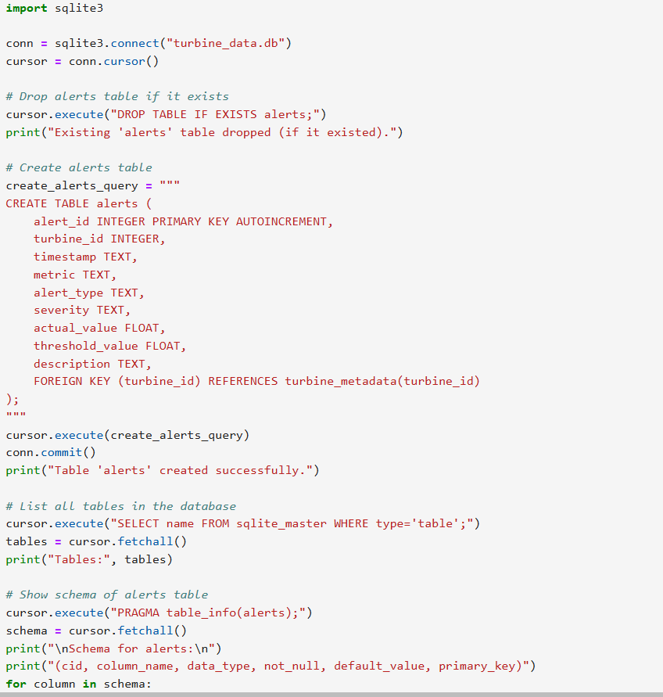
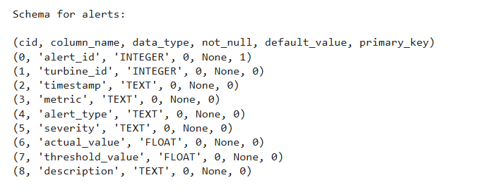
SQL TABLE CREATION
ALERT TABLE

Slide 22
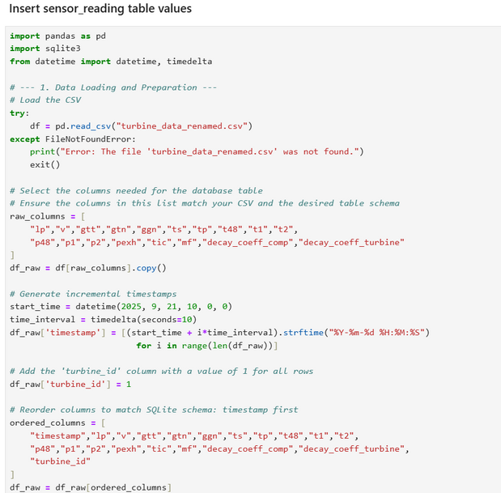
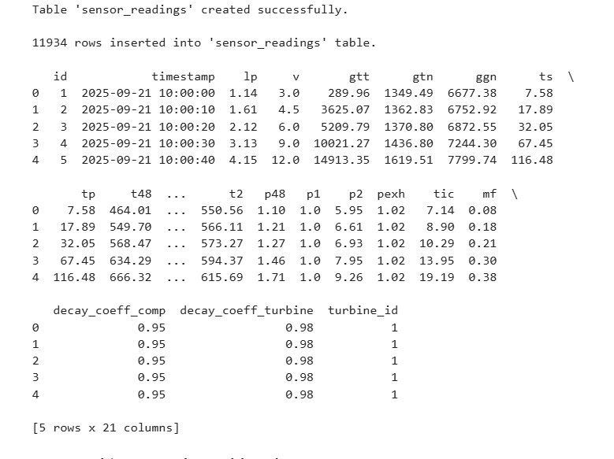
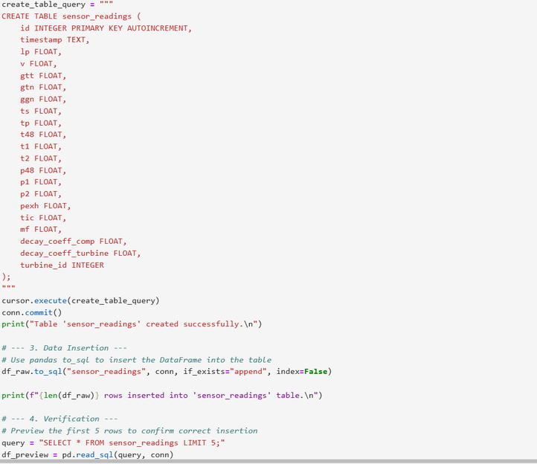
INSERT DATA IN
SENSOR READINGS TABLE

Slide 23
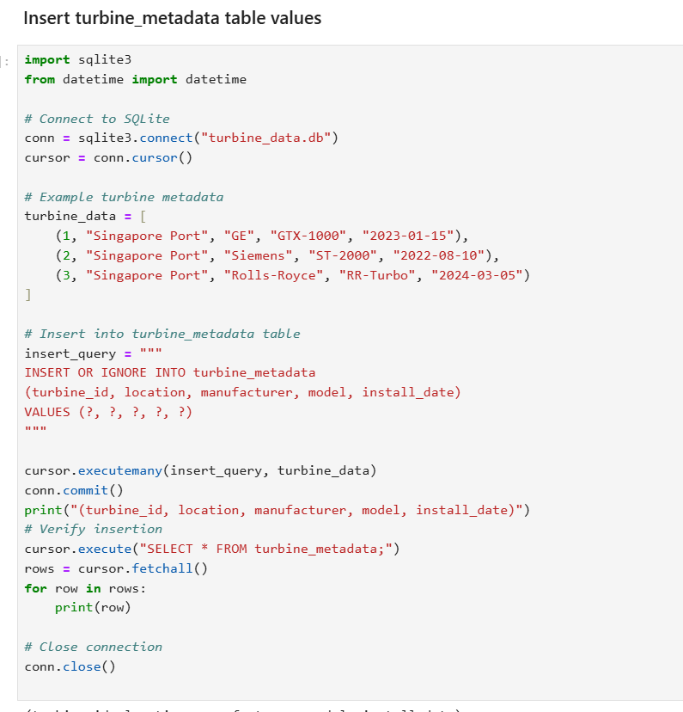
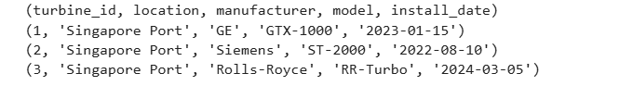
INSERT DATA IN
TURBINE METADATA TABLE

Slide 24
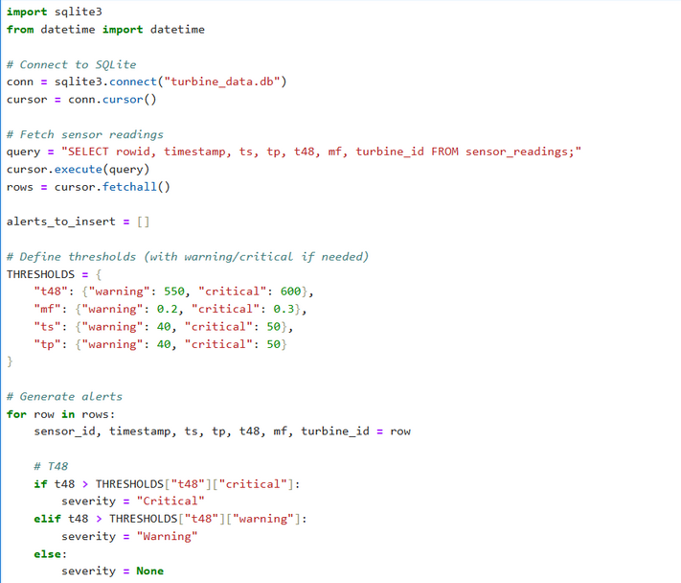
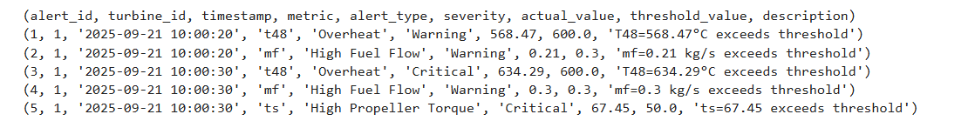
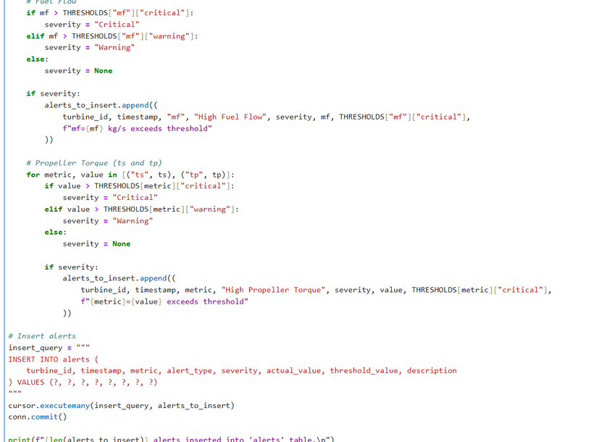
INSERT DATA IN
ALERT TABLE

Slide 25
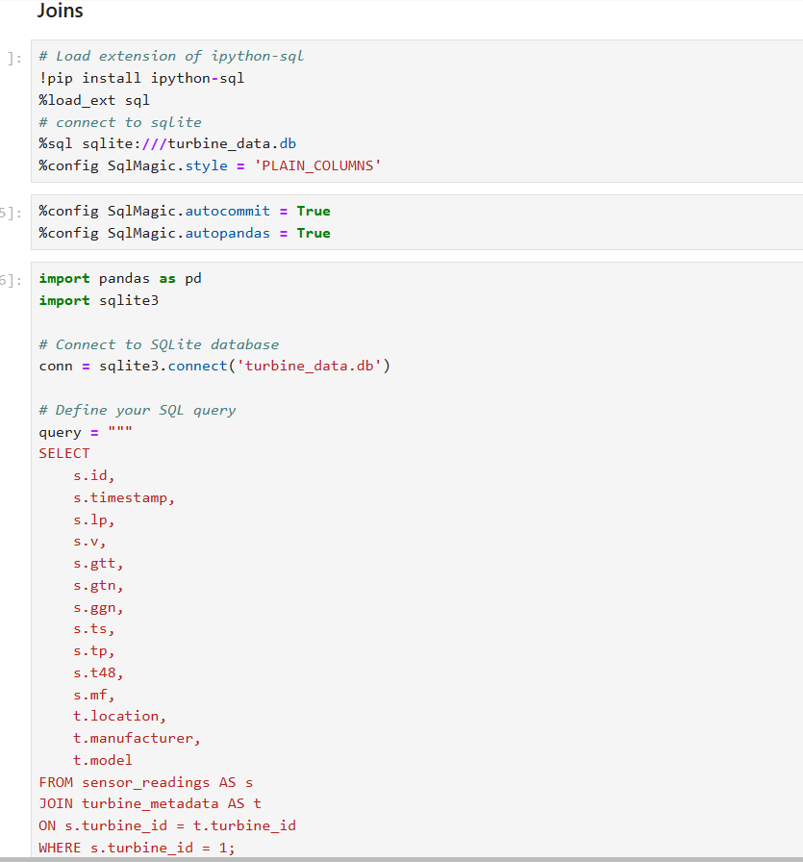
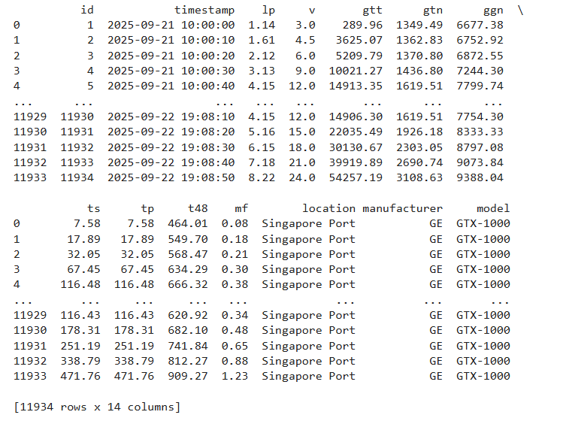
SQL TRANSFORMATIONS
JOINS

Slide 26
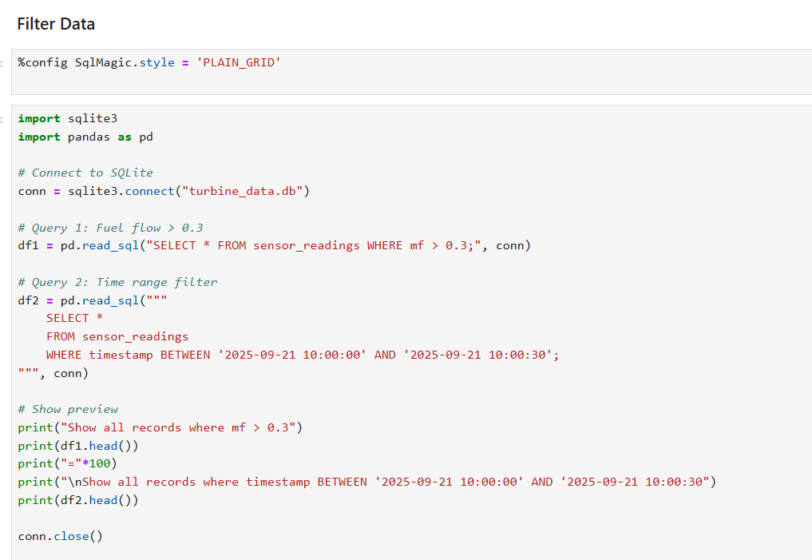
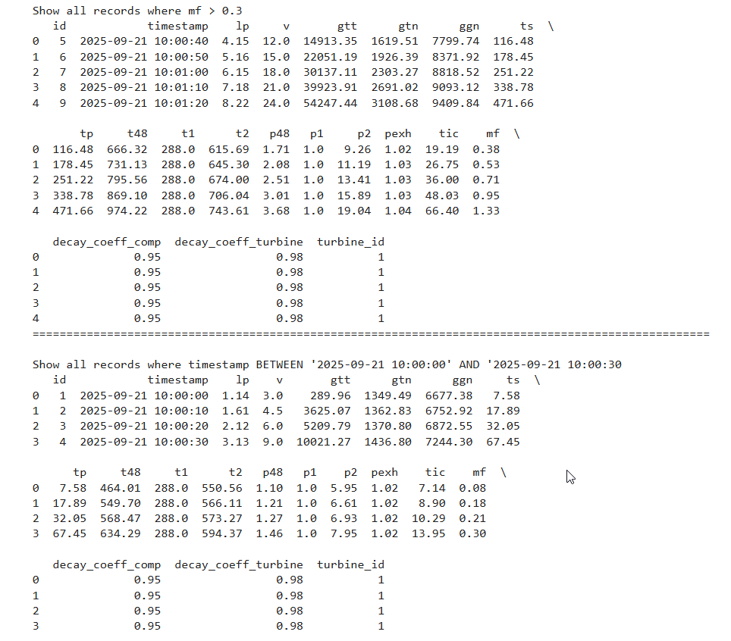
SQL TRANSFORMATIONS
FILTERS

Slide 27
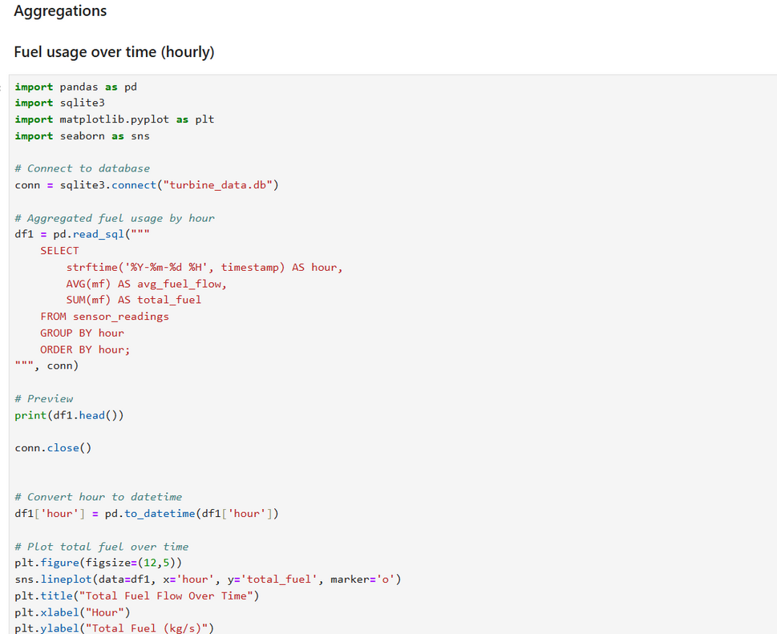
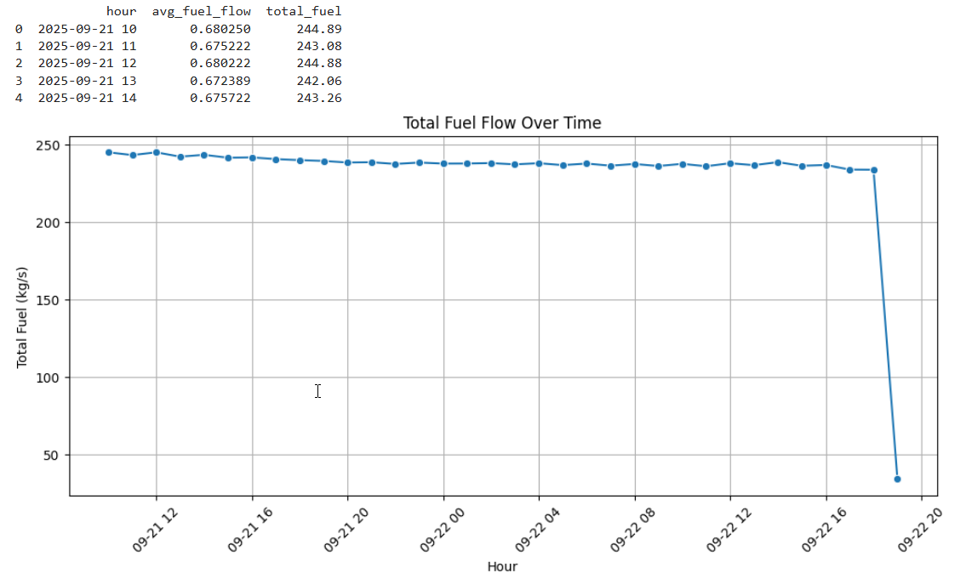
SQL TRANSFORMATIONS
AGGREGATION

Slide 28
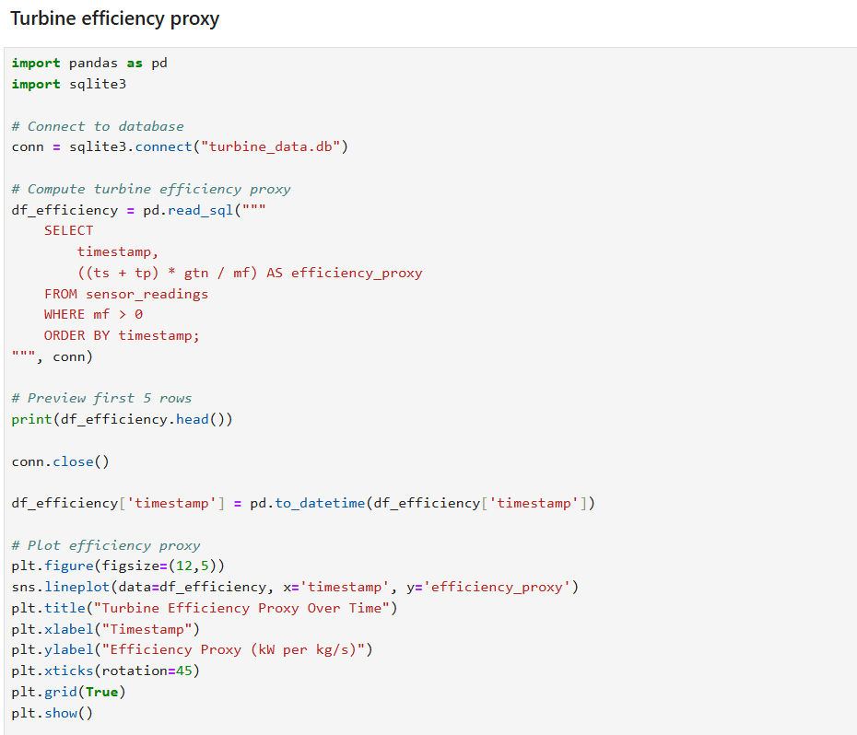
ANALYZE
FUEL USAGE PATTERNS OVER TIME & TURBINE EFFICIENCY COMPARISONS

Slide 29
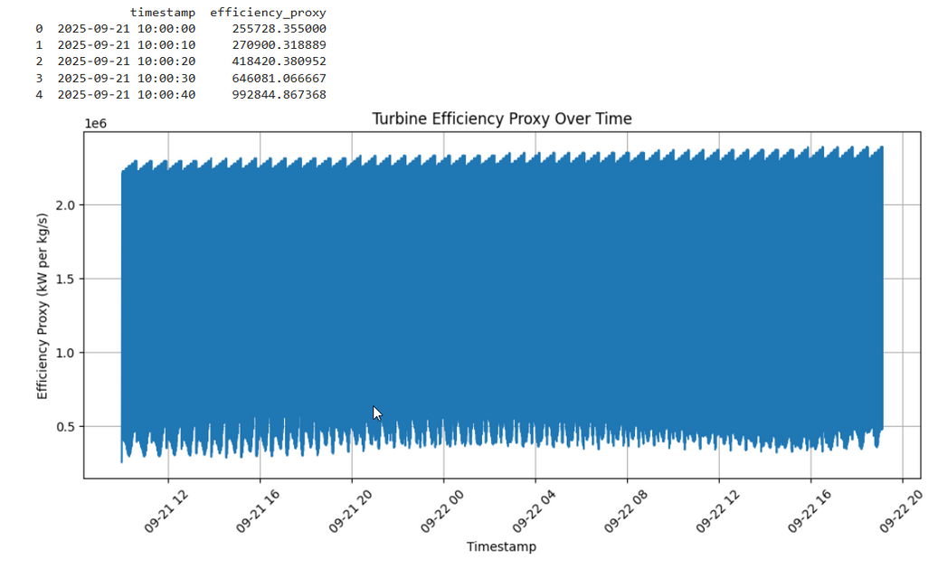
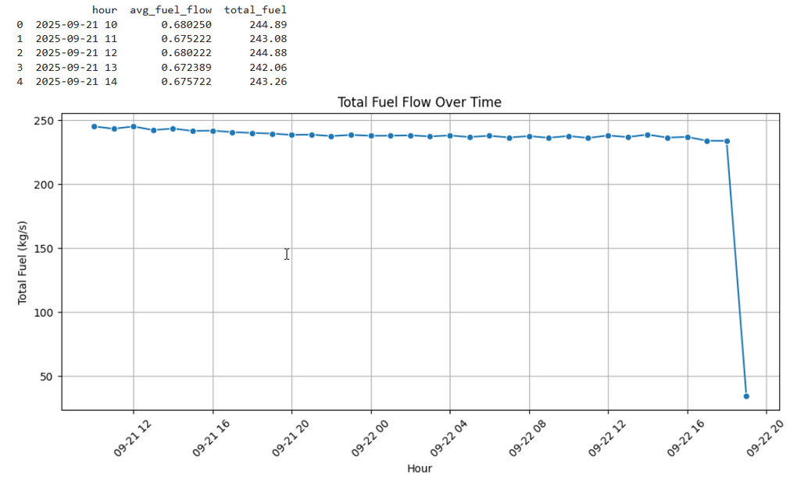
VISUALIZE RESULTS USING MATPLOTLIB / SEABORN

Slide 30
Tasks
Simulate ETL pipeline using Python scripts and Azure
Data Factory:
o Extract: Load CSVs from local storage to Azure Data Lake Gen2.
o Transform: Cleaned sensor logs processed into silver layer. o Load: Store curated data into structured Azure storage (simulated with CSV or SQL).
Integrate sensor data into hierarchical ADLS folders
PHASE 4

Slide 31
ETL PIPELINE

Slide 32
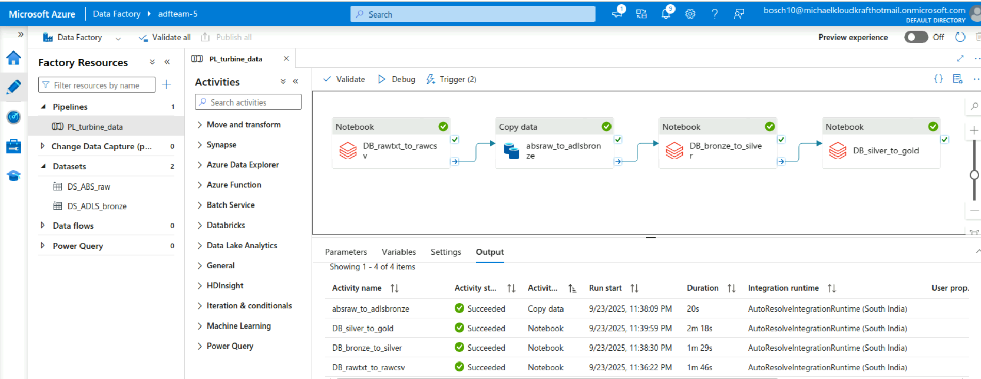

Slide 33
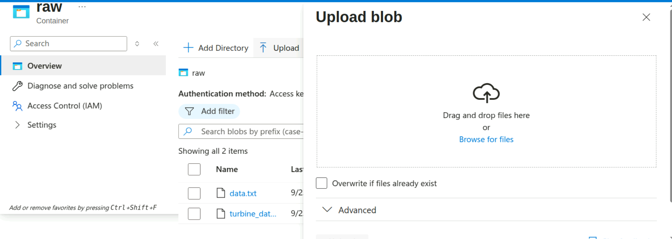
Extract: Load CSVs from local storage to Azure Data Lake Gen2
The data.txt file is converted to .csv file and loaded back to raw container

Slide 34
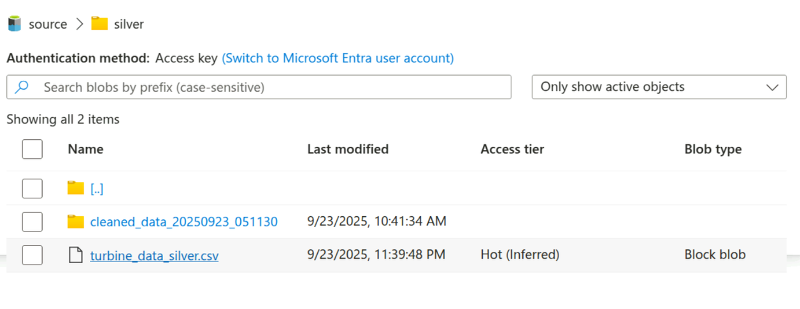
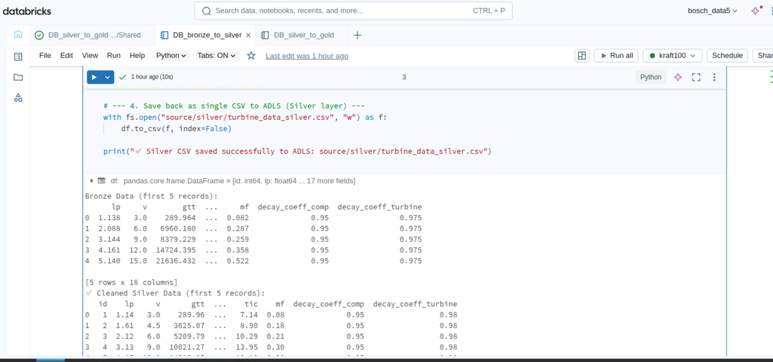
Transform: Cleaned sensor logs processed into silver layer

Slide 35
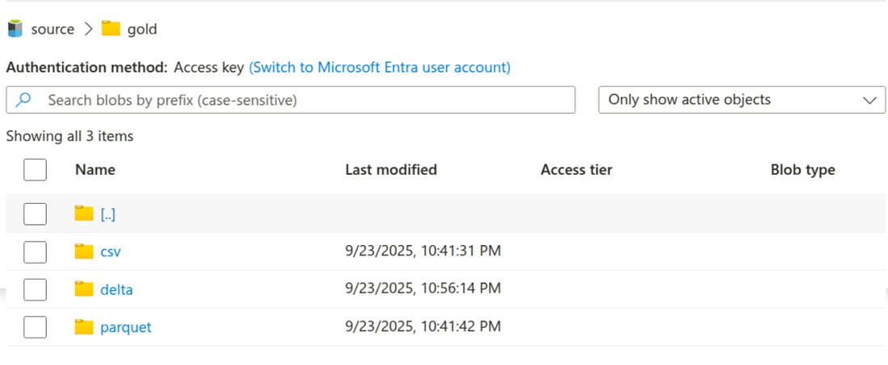
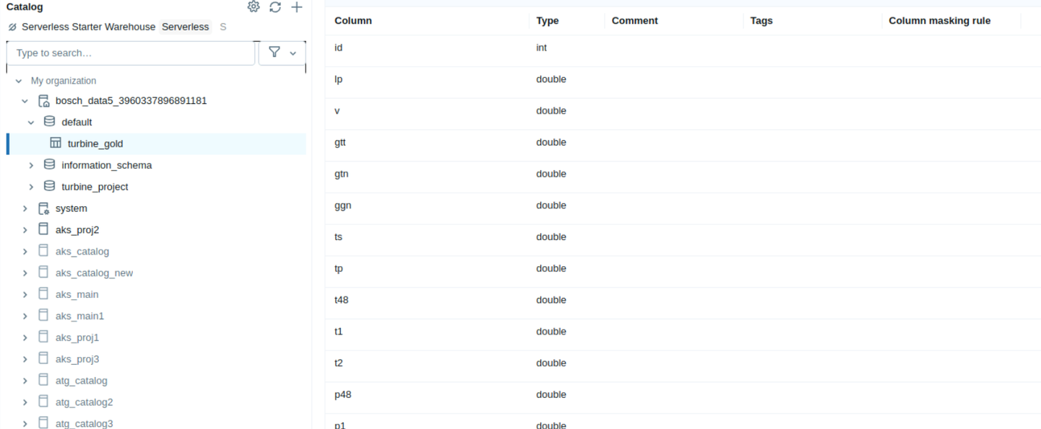
Load: Store curated data into structured Azure storage

Slide 36
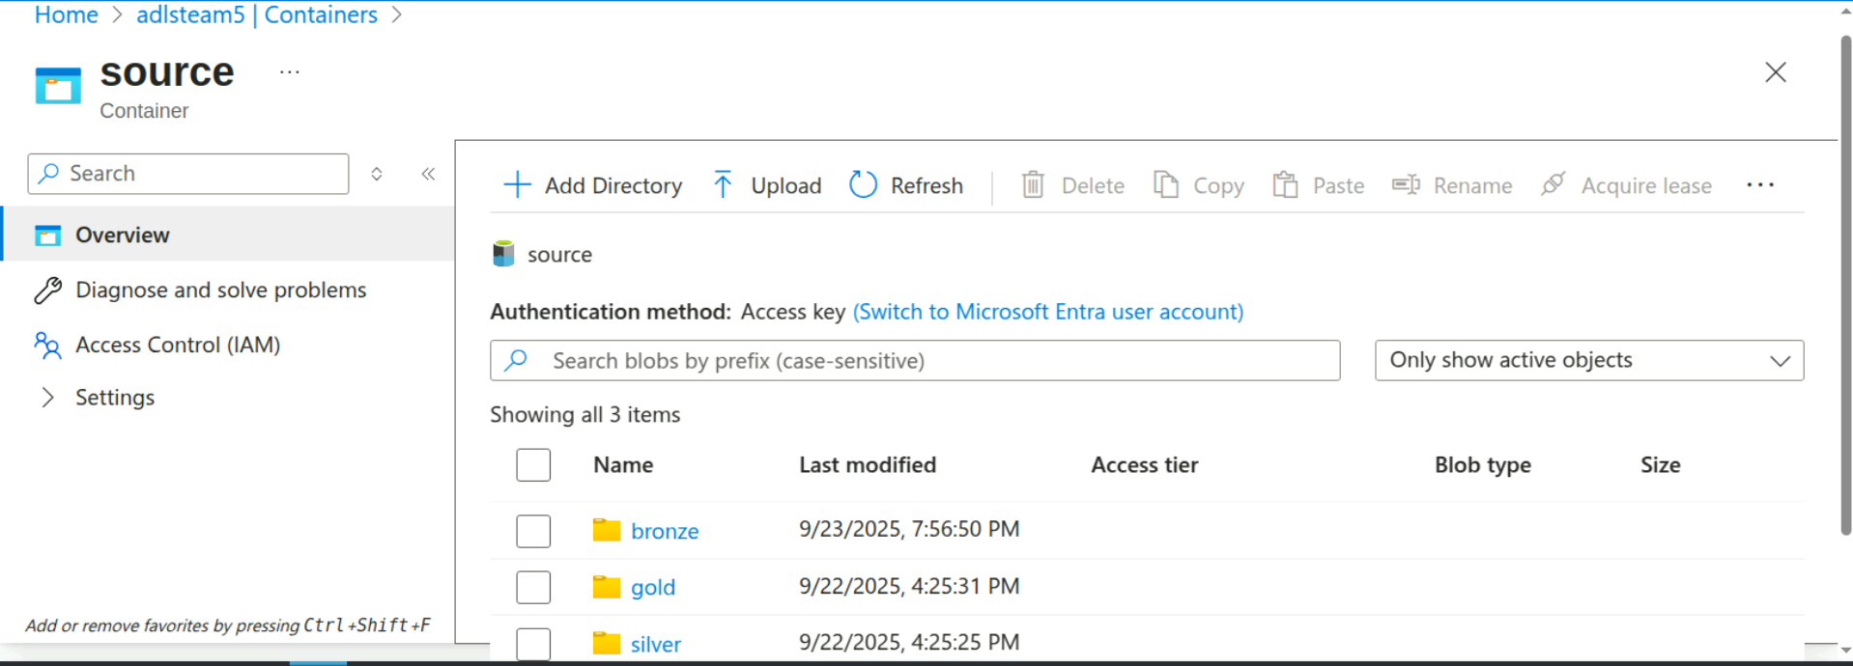
Hierarchical ADLS folders

Slide 37
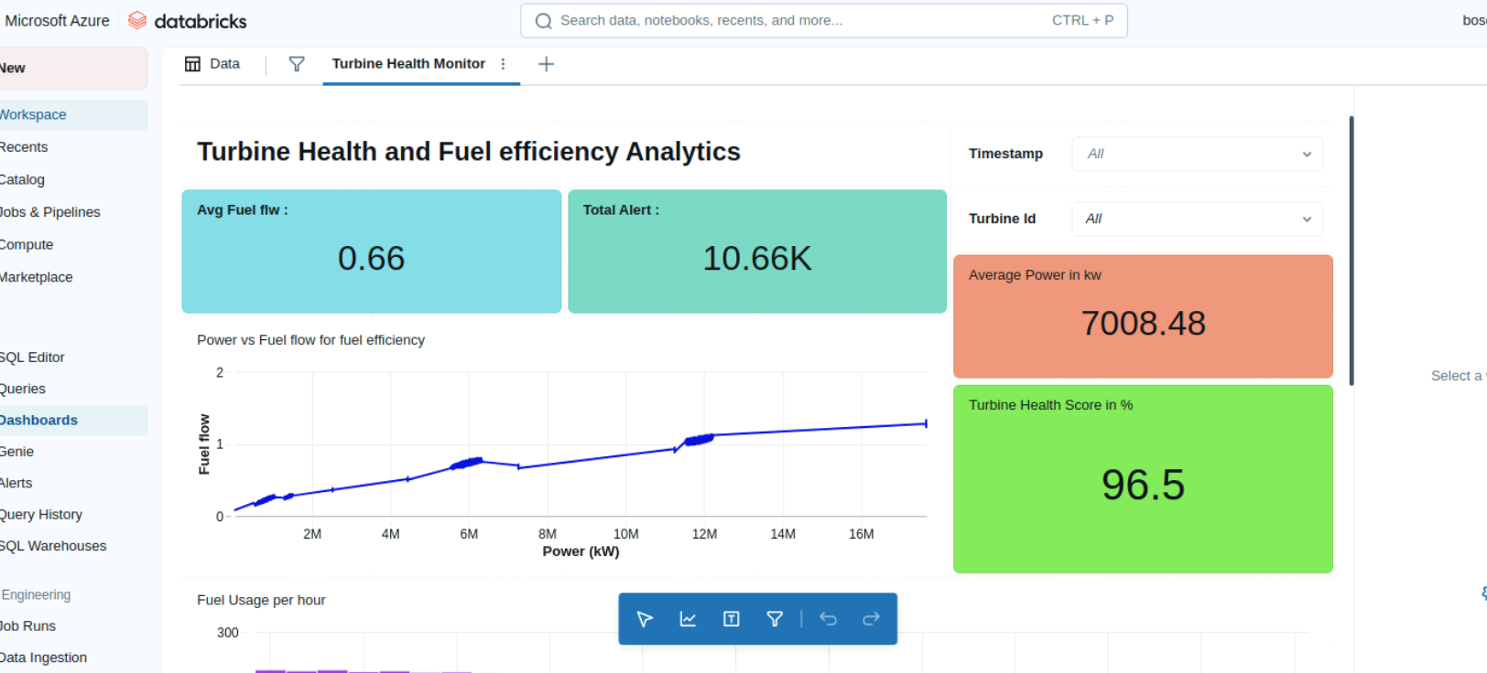

Slide 38
Tasks
Build FastAPI-based endpoints:
o GET /health-summary – aggregate fuel usage & decay status.
o GET /sensor-metrics – recent telemetry for a turbine.
o POST /anomaly-alerts – log new anomaly detection.
Use Pydantic for schema validation.
Expose Swagger documentation and enable file uploads.
PHASE 5

Slide 39
FAST API ENDPOINTS

Slide 40
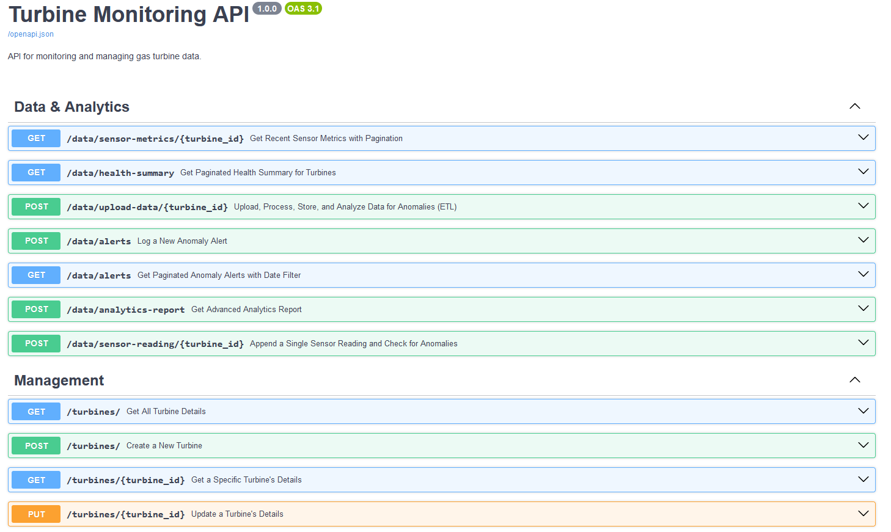

Slide 41
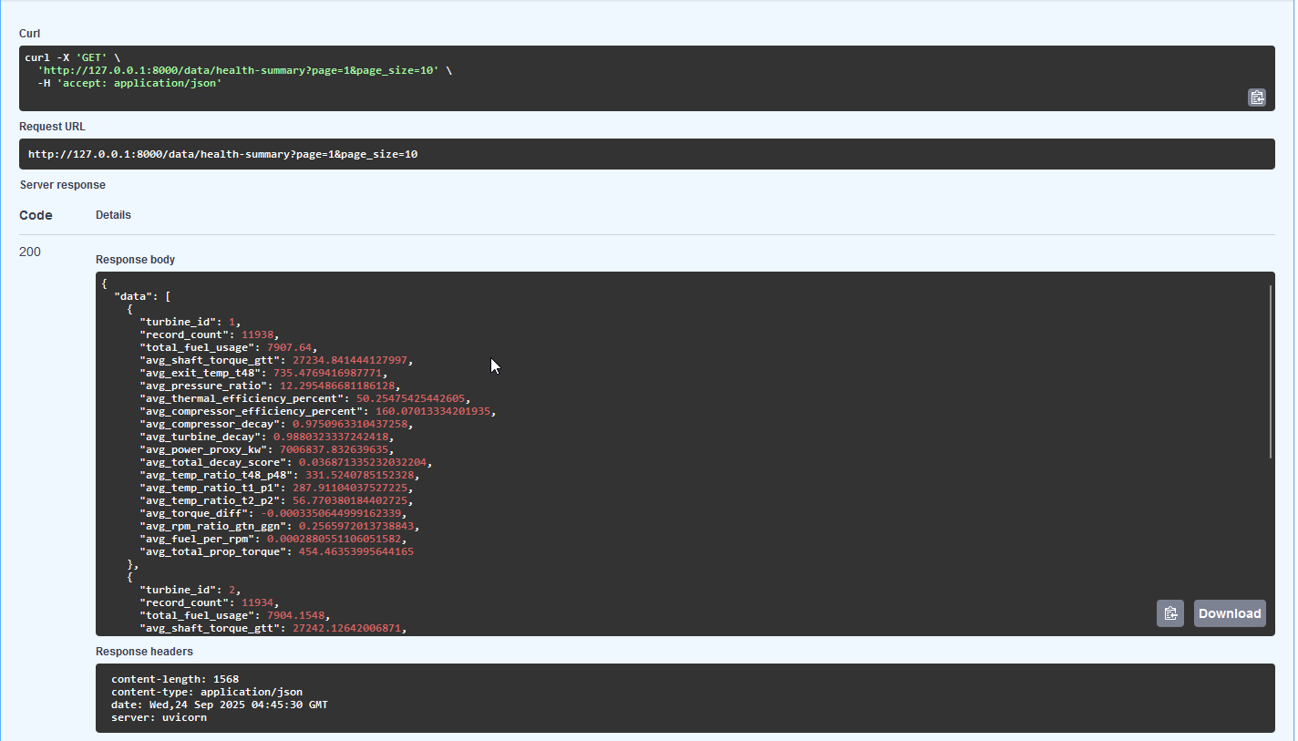
GET /health-summary

Slide 42

GET /sensor-metrics

Slide 43

GET /anomaly-alerts

Slide 44


Pydantic for schema validation

Slide 45


file uploads in Swagger to tables

Slide 46
Tasks
Write unit tests using pytest for:
o Data ingestion
o API endpoints
o KPI calculations
Prepare Test Summary Report:
o Pass/Fail table
o Defect logs
Define Acceptance Criteria:
o Data load time thresholds
o API uptime
o Alert trigger latency
PHASE 6

Slide 47


Acceptance Criteria

Slide 48




Slide 49

Pass / Fail Table

Slide 50
THANK YOU

